Slide 1
Git Demystified
Matthew Ramir // Midcamp 2023 // @crasx

Slide 2
A little about /u/crasx
Chicago -> Denver
BS in CS @ University of Illinois (Chicago).
Started playing with Drupal in 2012 (Drupal 7)
Lead Developer - DevOps enthusiast.
Disabled (Cerebral Palsy)
Matthew Ramir
they/them/null

Slide 3


Notes:
Founded in 2003 in Chicago, Bounteous is a leading digital experience consultancy that co-innovates with the world's most ambitious brands to create transformative digital experiences. With services in Strategy & Insights, Experience Design, Technology, Analytics, and Marketing, Bounteous elevates brand experiences and drives superior client outcomes.

Slide 4
Follow along
https://ramir.dev/mc23

Slide 5
How We’ll Spend Today
Git intro
Concepts, initializing a repo
Git objects
How git remembers changes
Git commands
How git commands modify objects
AGENDA

Slide 6
Warning - Technical talk
I am making assumptions about your knowledge level.
You should be familiar with the command line.
Previous use of git will help but isn’t required.

Slide 7

Context
Lots of shell code
Commands are uncommented
Command output is commented for clarity

Slide 8
Git in the groove
Git is an open-source version control system
Tracks changes to files over time
Created by Linus Torvalds in 2005 for the development of the Linux kernel
Used by the Drupal project to track changes to Drupal
The most widely used version control systems in software development
Notes:
70%? https://abdalslam.com/version-control-systems-statistics

Slide 9
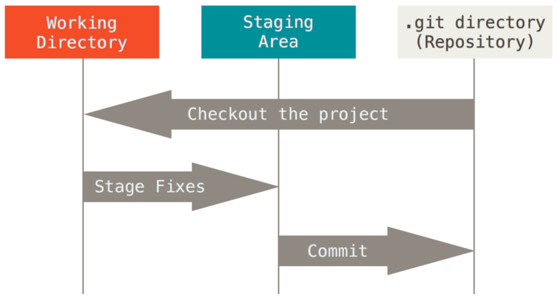
Git basics
Changes are made to your working directory
Changes are added to the staging area
The staging area is “committed” to .git
Permanent change in your history
https://git-scm.com/book/en/v2/Getting-Started-What-is-Git%3F

Slide 10
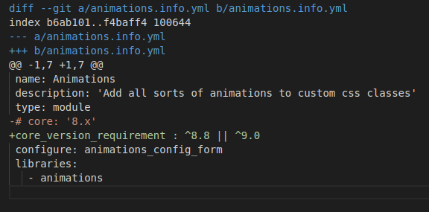
Patch files?
Git stores snapshots, not diffs

Slide 11
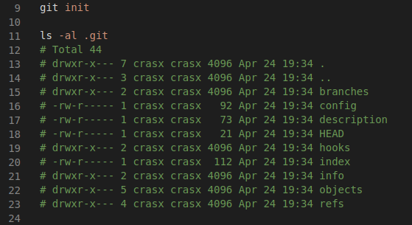
Create A Repository
Git does all of its magic via a hidden .git directory

Slide 12
Create A Repository
Git does all of its magic via a hidden .git directory
.git/config holds info about remotes and branches

Slide 13
Create A Repository
Git does all of its magic via a hidden .git directory
.git/config holds info about remotes and branches
.git/HEAD is the currently active commit

Slide 14
Create A Repository
Git does all of its magic via a hidden .git directory
.git/config holds info about remotes and branches
.git/HEAD is the currently active commit
.git/index is your “staging area”

Slide 15
Create A Repository
Git does all of its magic via a hidden .git directory
.git/config holds info about remotes and branches
.git/HEAD is the currently active commit
.git/index is your “staging area”
.git/objects/ stores all of your data

Slide 16
Create A Repository
Git does all of its magic via a hidden .git directory
.git/config holds info about remotes and branches
.git/HEAD is the currently active commit
.git/index is your “staging area”
.git/objects/ stores all of your data
.git/refs/ stores references to .git/objects/

Slide 17
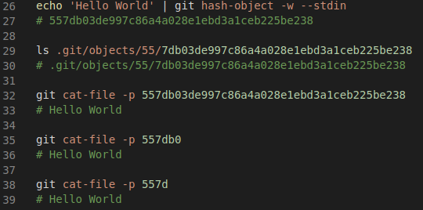
Object ID/Hash
Objects are identified by an object ID
An object ID is the hash of its contents
sha1/sha256
Notes:
The -w flag creates an object in the DB
557db is not the hash of the literal string
The hash size for the SHA1 algorithm is 160 bits. 160/4 bits/char = 40 chars

Slide 18
Object ID/Hash
Objects are identified by an object ID
An object ID is the hash of its contents
sha1/sha256
Objects can be referenced by partial hash
Notes:
The -w flag creates an object in the DB
557db is not the hash of the literal string
The hash size for the SHA1 algorithm is 160 bits. 160/4 bits/char = 40 chars

Slide 19
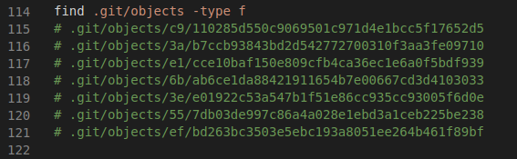
Objects The Brain of Git
All objects are stored in a file in .git/objects
No file extension
Objects have different types
Blob, Tree, Commit

Slide 20
Blob Objects
Blob objects store the contents of a file
Snapshot in time
No metadata
Single file, whole file, nothing but the file (plus some git stuff)
Blob objects are created when you run “git add”

Slide 21
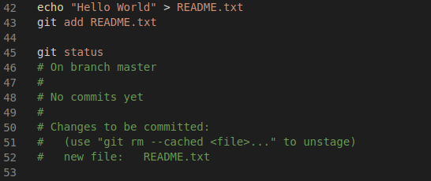
Staging Changes
-
“git add” stages a change for commit
“git status” shows us what is staged
Notes:
0 after hash is flags for conflicts

Slide 22
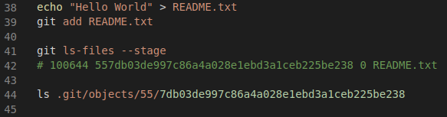
Staging Changes
-
The “staging area” is a single file .git/index
git ls-files gives us the contents of the index
Each entry has metadata
Permissions bits
Object ID
Conflict status
File name
Notes:
0 after hash is flags for conflicts

Slide 23
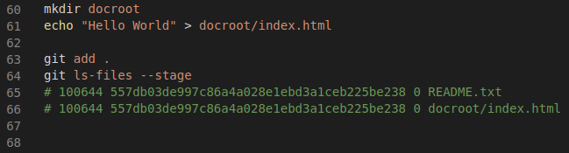
Staging changes
-
The staging area can hold multiple files

Slide 24
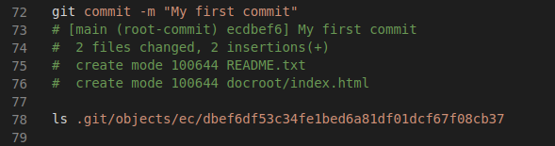
Committing changes
A commit is a collection of changes
Can be multiple files
Git commit takes the files in your staging area and puts them in a commit object

Slide 25
Committing changes
A commit is a collection of changes
Can be multiple files
Git commit takes the files in your staging area and puts them in a commit object
Commit objects are identified by a hash

Slide 26
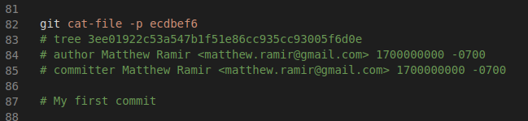
Commit object
Contains author info

Slide 27
Commit object
Contains author info
Contains commit message

Slide 28
Commit object
Contains author info
Contains commit message
Contains tree object!

Slide 29
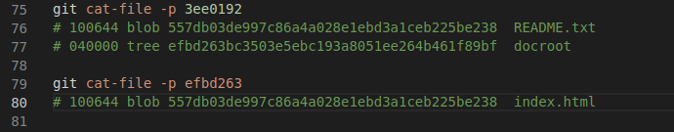
Tree objects
Trees point to blobs
Trees point to other trees

Slide 30
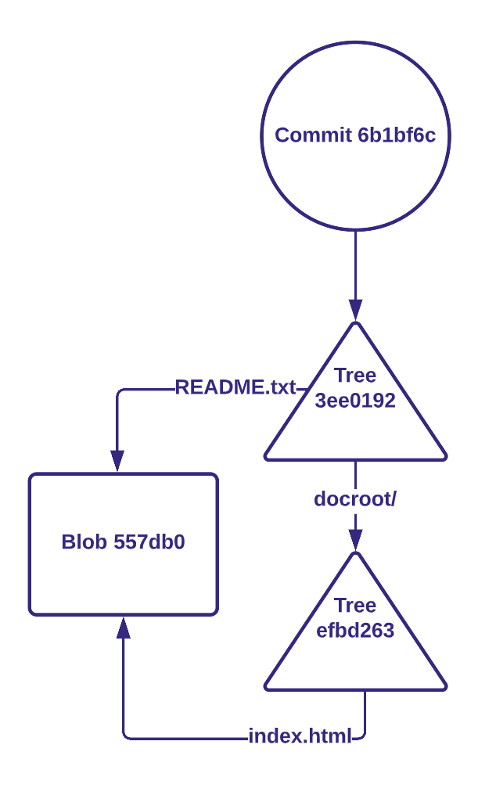
Objects

Slide 31
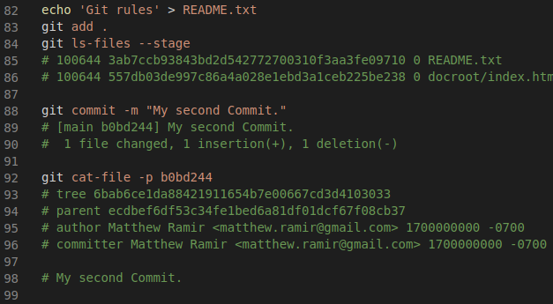
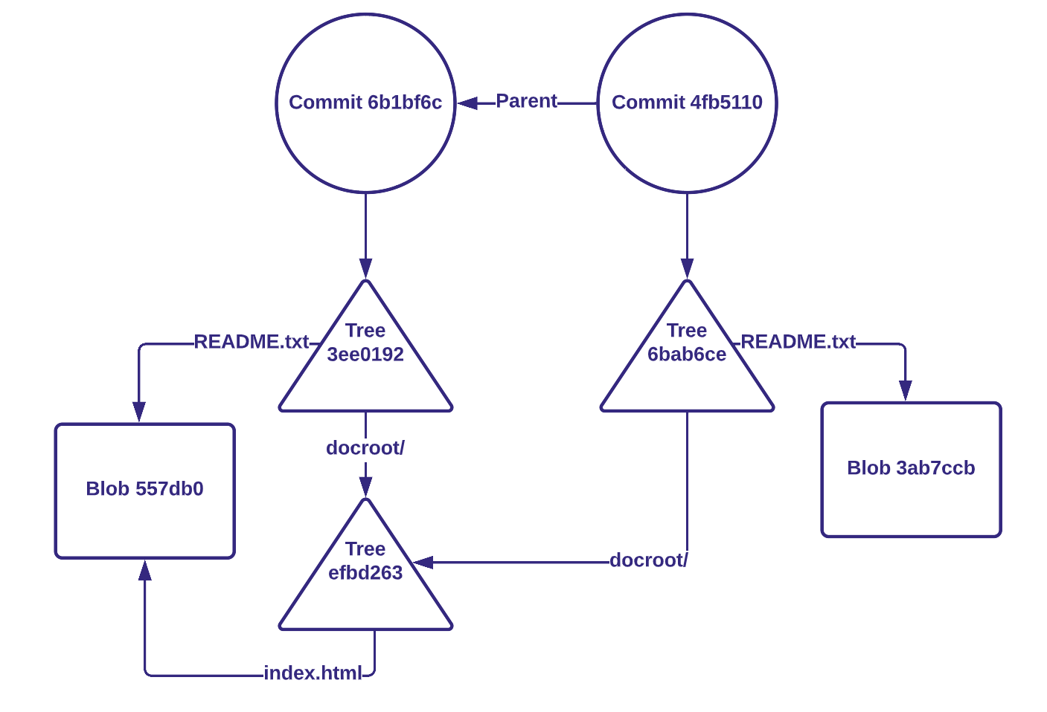
Adding complexity

Slide 32
Question Break
Notes:
Who wants to guess what branches are?

Slide 33
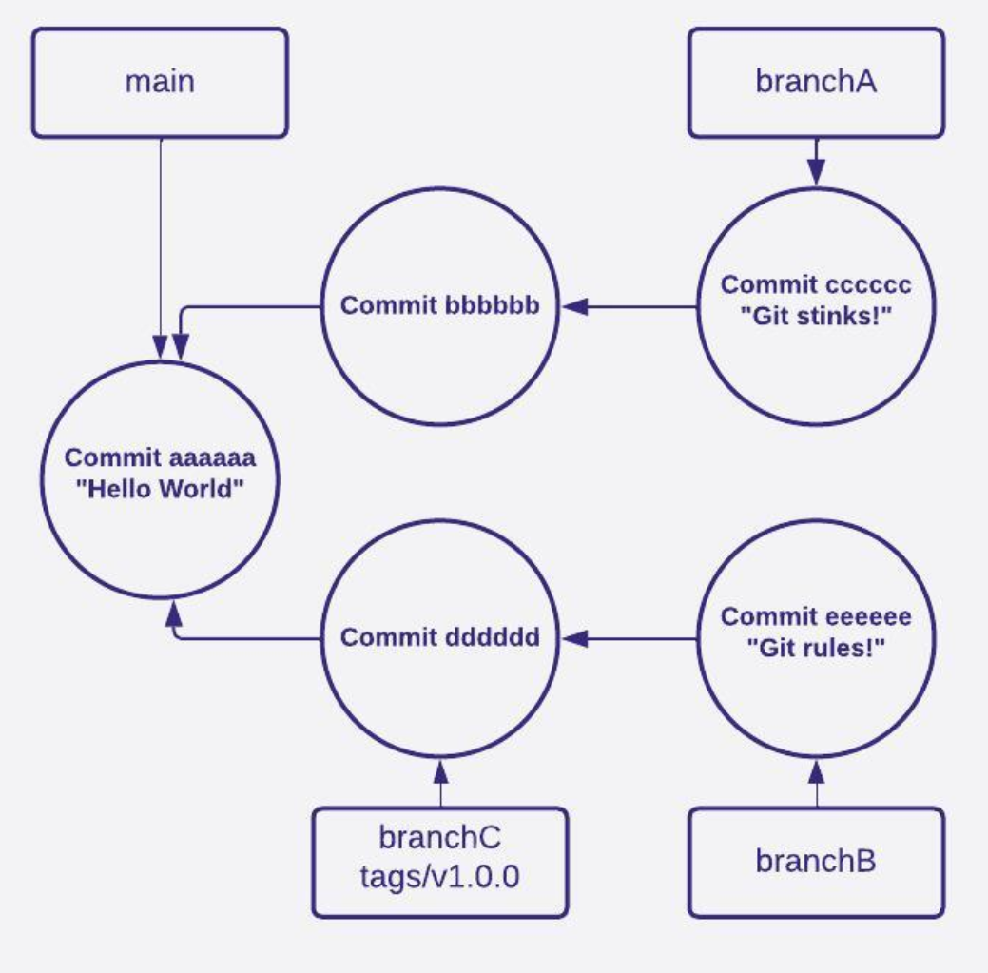
Git References

Slide 34
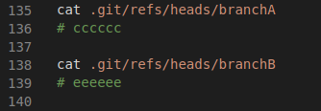
Git References

Slide 35
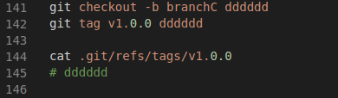
Git References

Slide 36
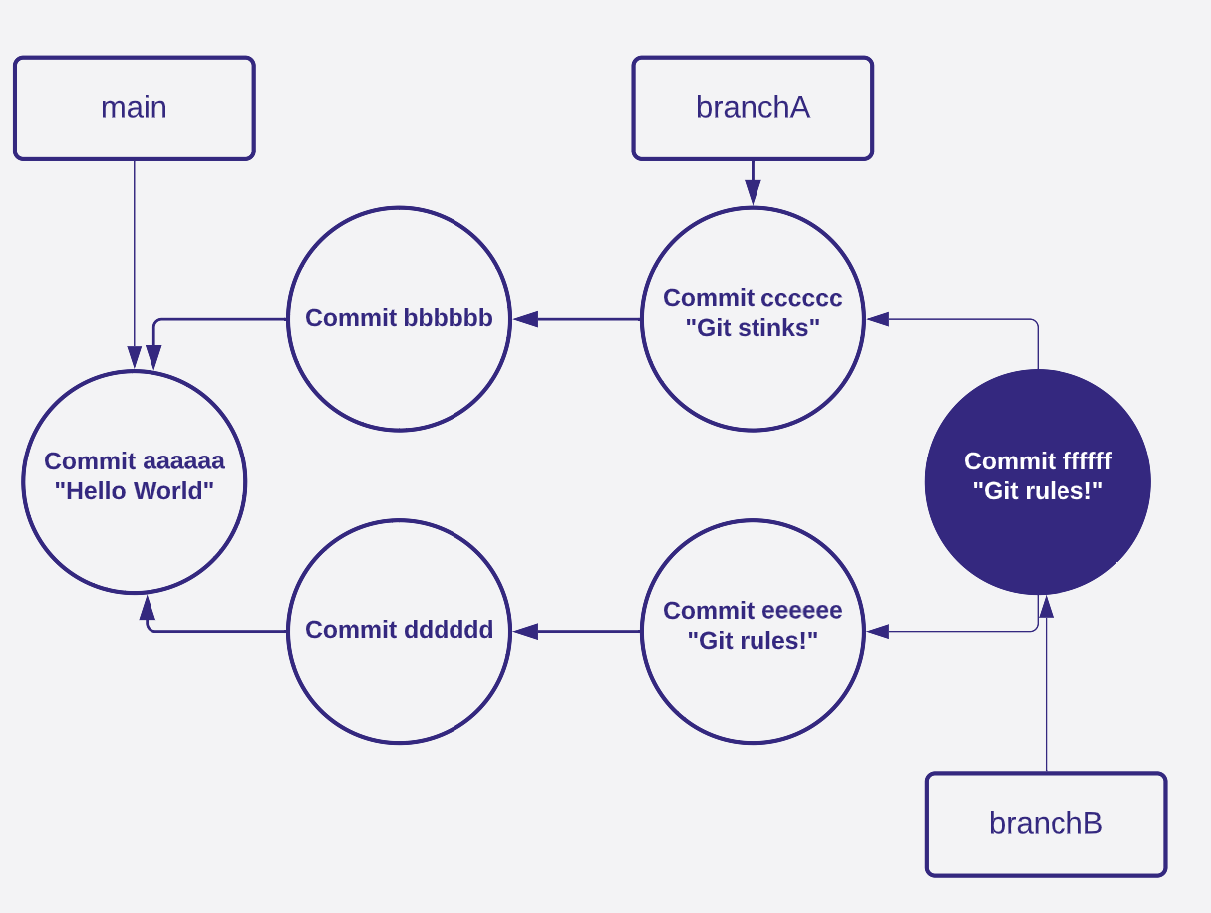
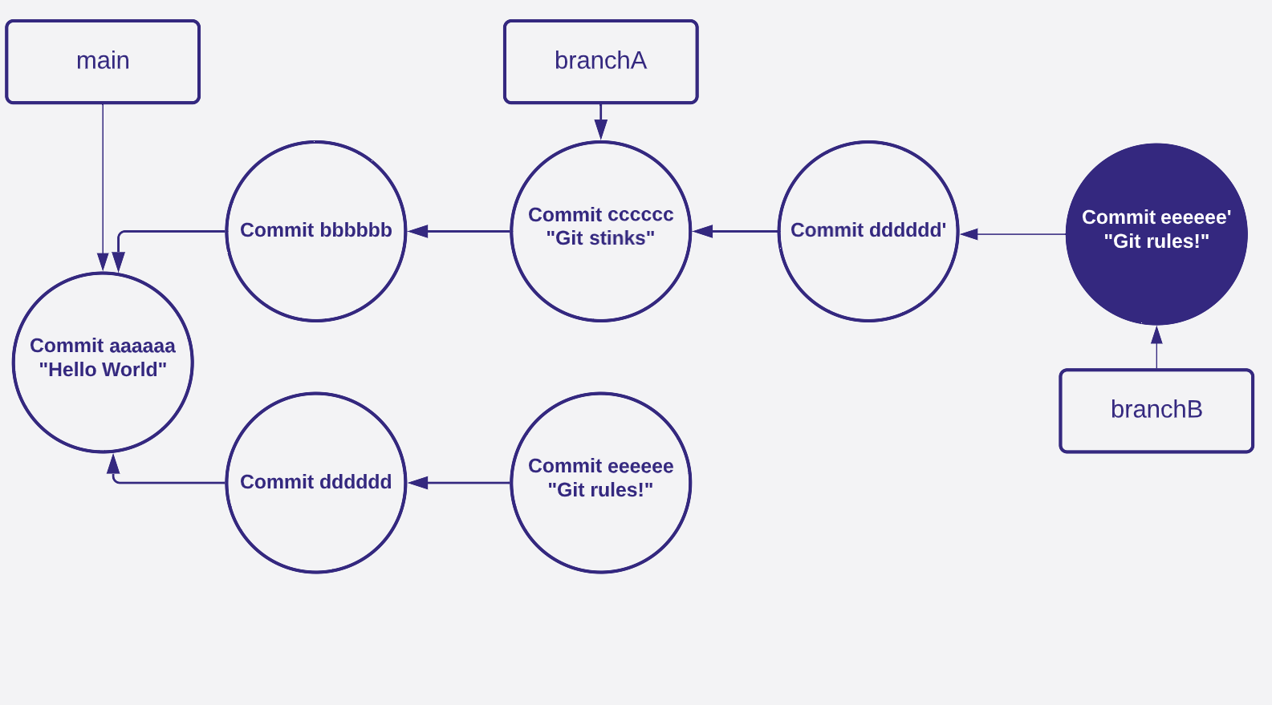
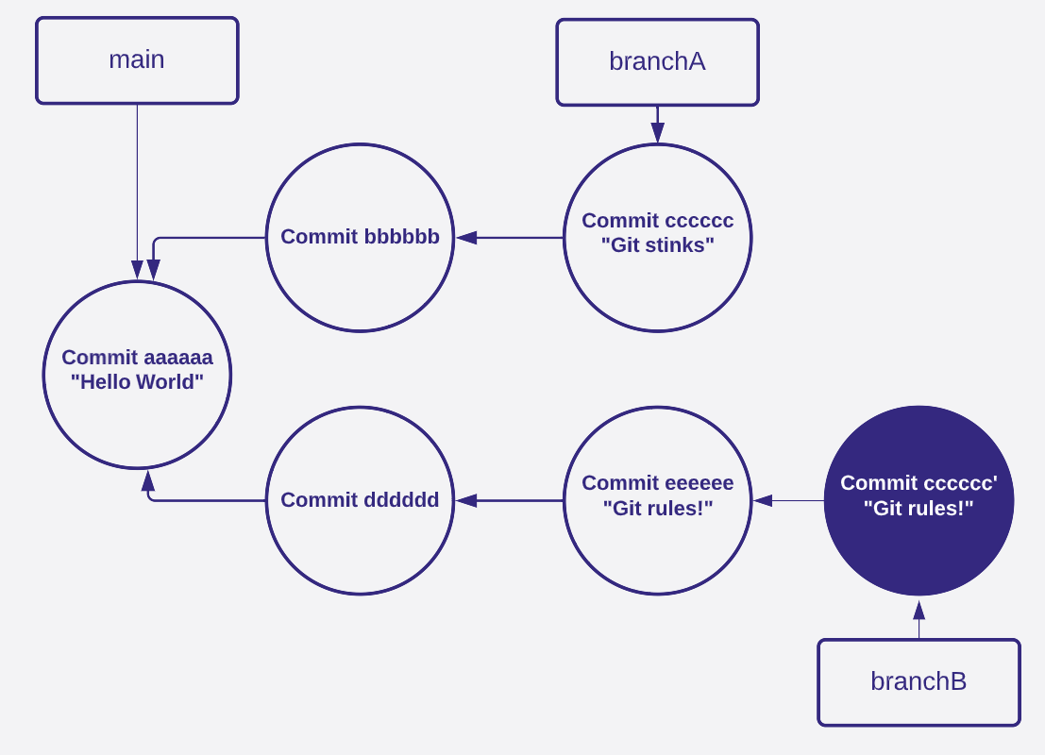
Merge vs Rebase vs Cherry-pick

Slide 37

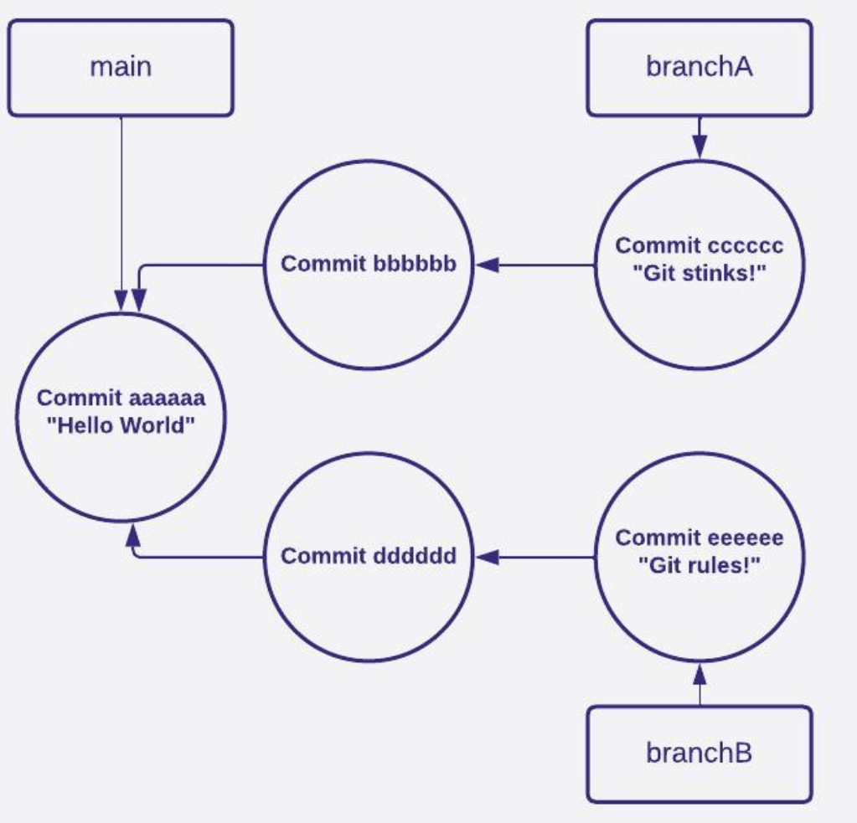
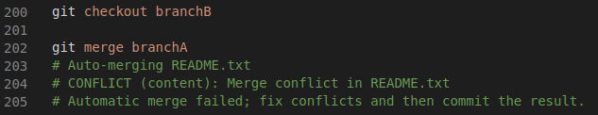
Git Merge

Slide 38
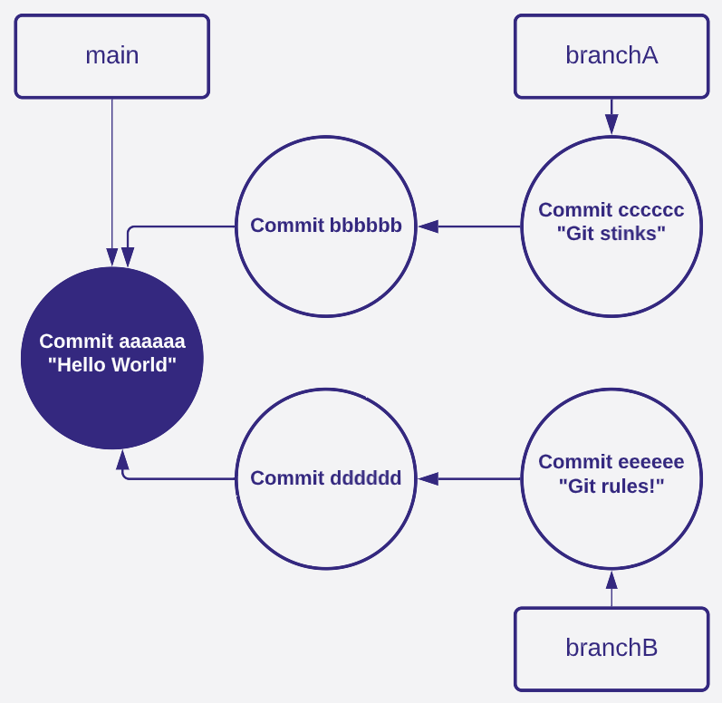
Git Merge
3 way merge (or more!)
Finds common ancestor (aaaaaa)

Slide 39
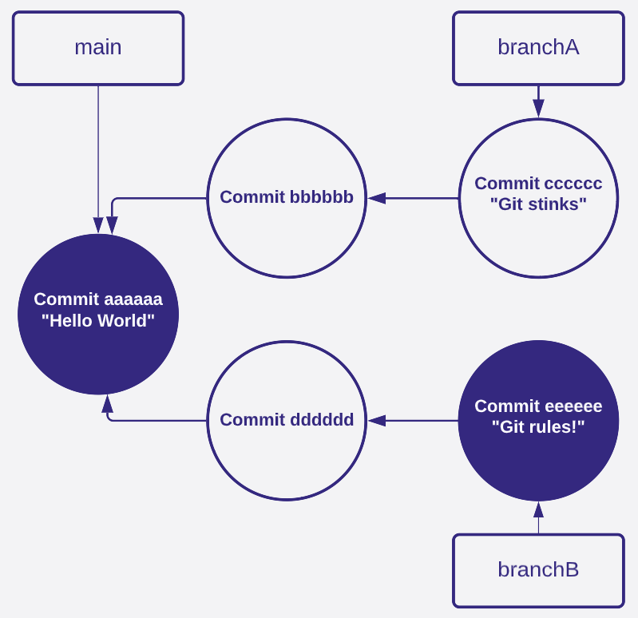
Git Merge
3 way merge (or more!)
Finds common ancestor (aaaaaa)
Computes diff between branchB and aaaaaa

Slide 40
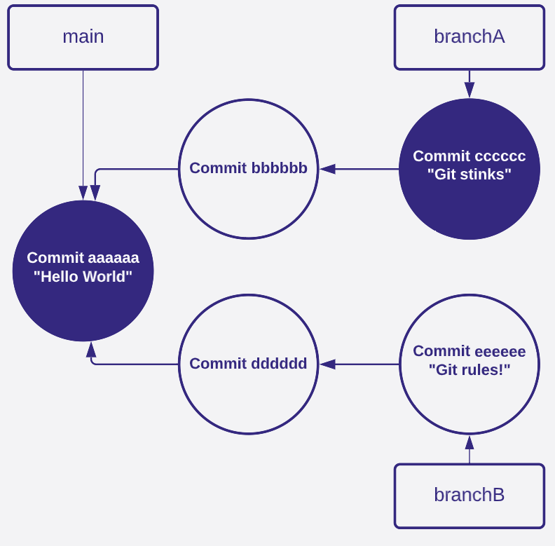
Git Merge
3 way merge (or more!)
Finds common ancestor (aaaaaa)
Computes diff between branchB and aaaaaa
Computes diff between branchA and aaaaaa

Slide 41
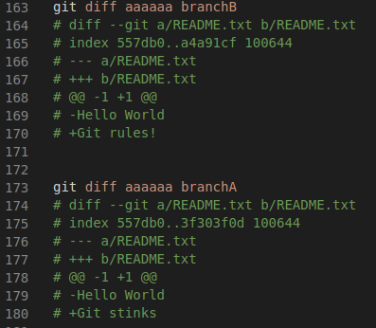
Git Merge
Changed bytes overlap!

Slide 42
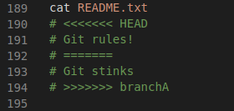
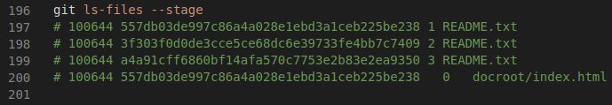
Git Merge

Slide 43
Git Merge
aaaaaa

Slide 44
Git Merge
aaaaaa
branchB (HEAD)

Slide 45
Git Merge
aaaaaa
branchB (HEAD)
branchA

Slide 46
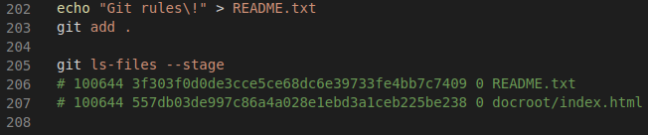
Git Merge

Slide 47
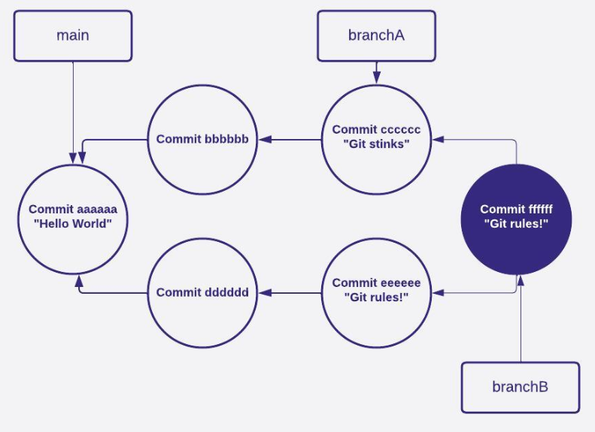
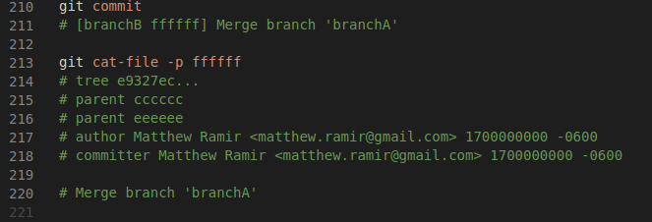
Git Merge

Slide 48
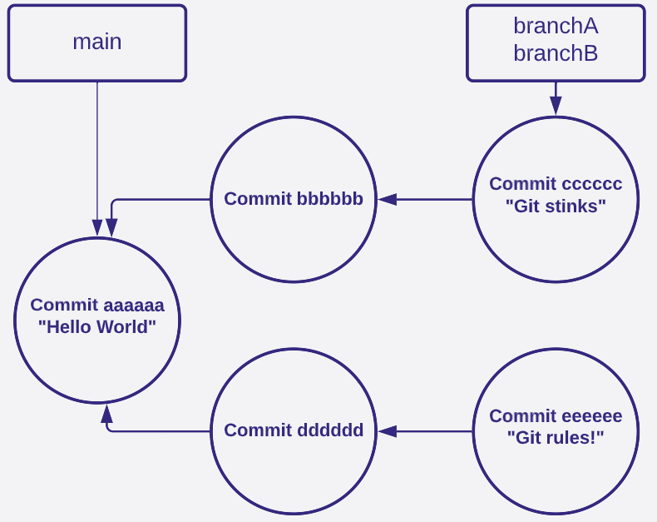
Git Rebase
Finds common ancestor (aaaaaa)
Point branch commit we are rebasing onto (cccccc)
Replay differences between aaaaaa and eeeee

Slide 49
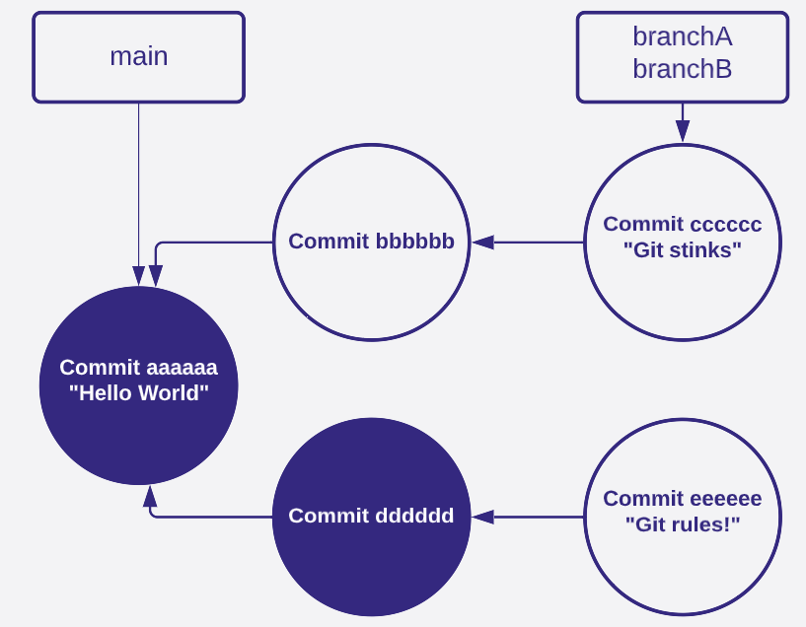
Git Rebase

Slide 50
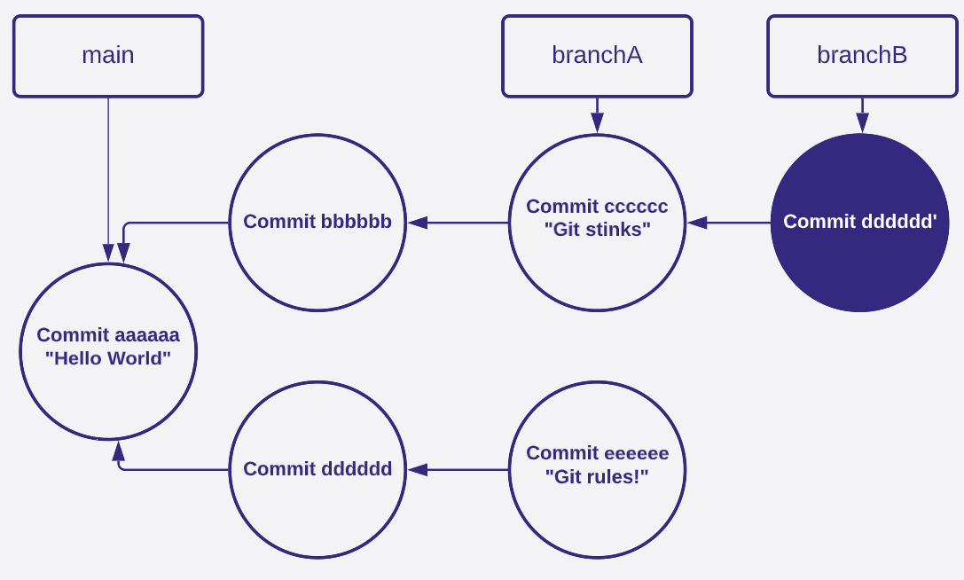
Git Rebase

Slide 51
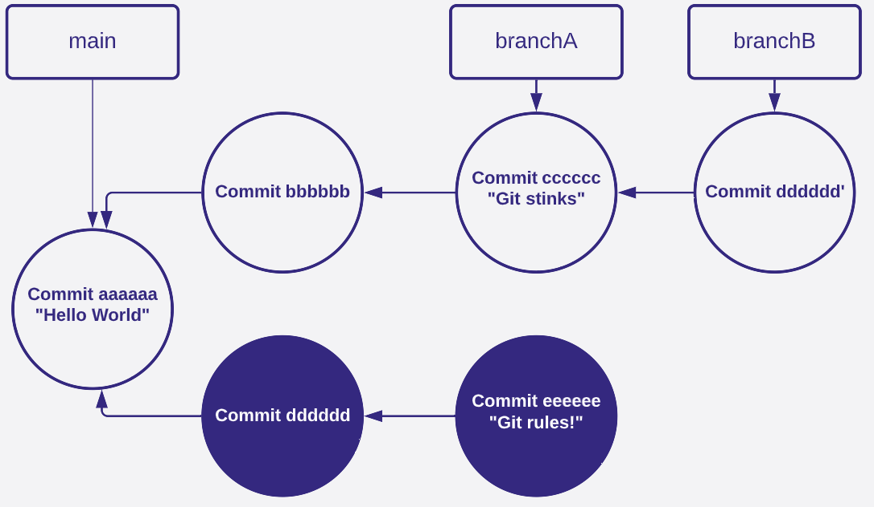
Git Rebase

Slide 52
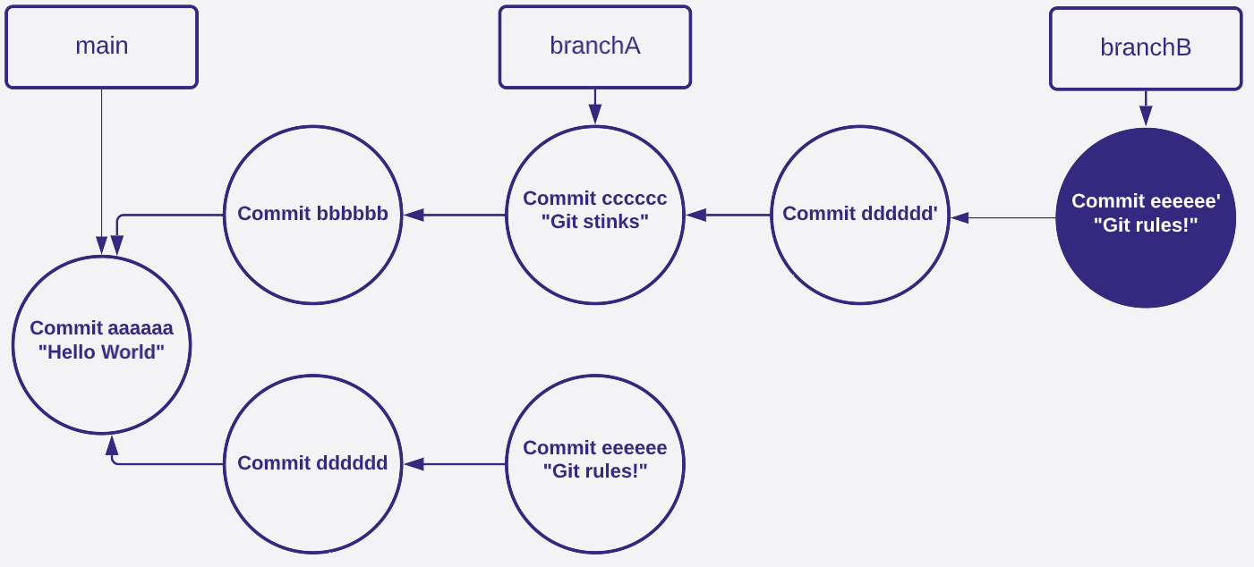
Git Rebase

Slide 53
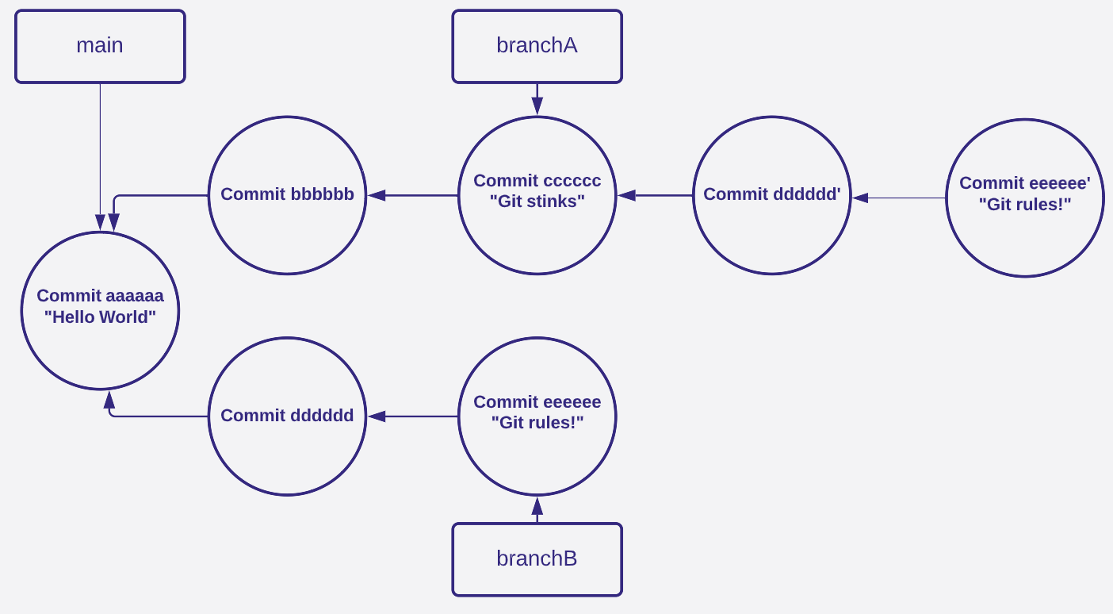
git reset --hard eeeeee

Slide 54
git cherry-pick
Get the commit we are cherry-picking (eeeeee)
Get diff between eeeeee and its parent

Slide 55
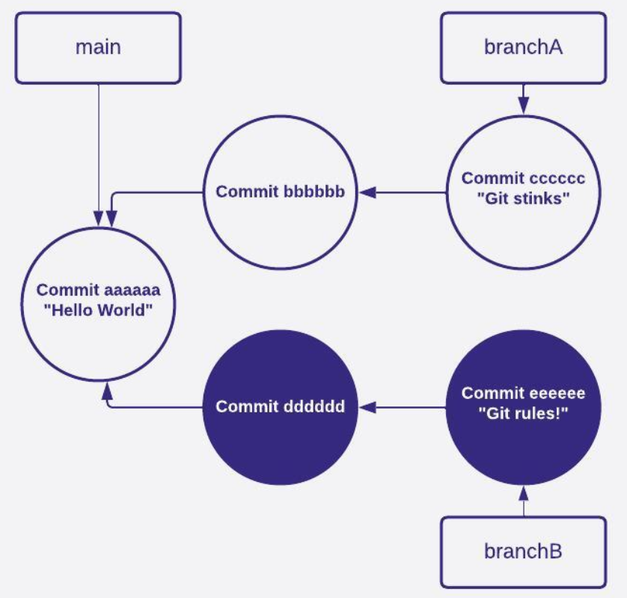
git cherry-pick
Get the commit we are cherry-picking (eeeeee)
Get diff between eeeeee and its parent

Slide 56
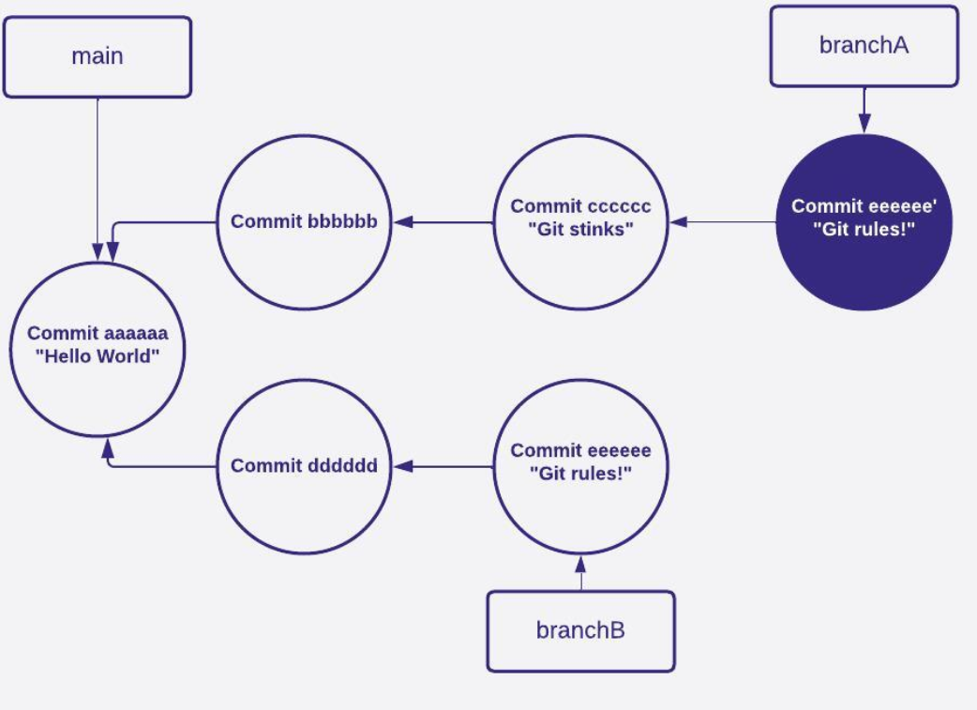
git cherry-pick
Get the commit we are cherry-picking (eeeeee)
Get diff between eeeeee and its parent
Create a new commit using diff (resolve conflicts)

Slide 57
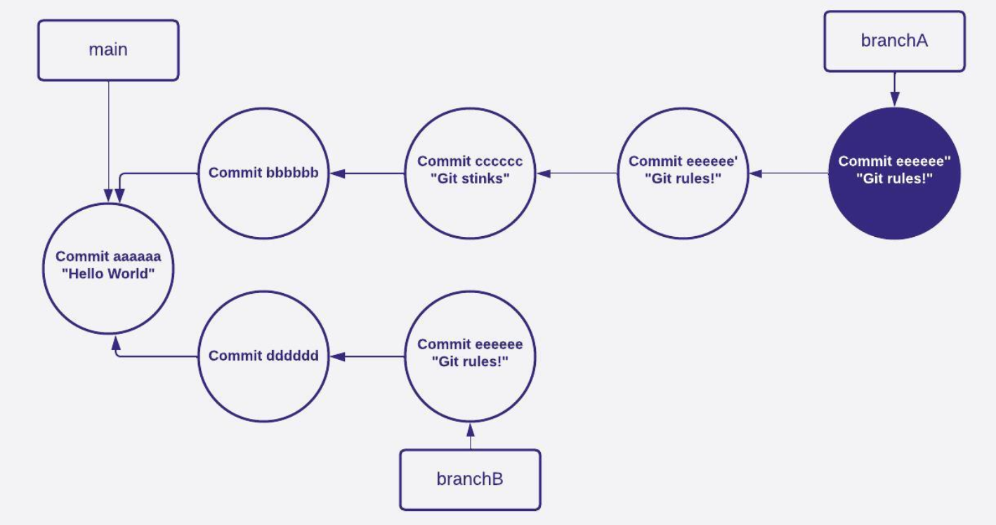
git cherry-pick

Slide 58
Summary
Git is a file based version control system that uses objects and refs to track changes
Git stores snapshots of files (not incremental changes)
Commits point to trees, trees point to blobs
Branches are pointers to commits, git doesn’t care what they point to

Slide 59
Pitter patter, let’s git at ‘er
Matthew Ramir
Questions?
crasx
matthew.ramir@bounteous.com
matthew.ramir@gmail.com

